Slide 1

Virtual Time and Global States of Distributed Systems
Mattern, F. (1989). Virtual time and global states of distributed systems. Parallel and Distributed Algorithms, 1(23), 215-226.
By Héctor Hugo Huipet Hernández

Slide 2
Main paper Contribution
Propose a generalized non-standard model of time (vector of clocks) for distributed systems
A new algorithm to compute a global snapshot of a distributed system with no strict order in message arrival

Slide 3
What we know of a distributed system
Several processes
No common memory
Communication messages only with unpredictable delays
Global time/ Global State → hard to know
Among other (termination, deadlock detection, symmetry breaking, election problem, etc.)

Slide 4
Events
Atomic actions that occur within a process
Types (Internal, Send, Receive)
Related:
IF receive_{e} exists THEN send_{e} must exist
Structure (E,<):
E → {Set of events:e₁…e_{n}}
< → partial order “causality relation”
“the future cannot influence the past”

Slide 5
Events
Causal structure of the computation

Slide 6

Events
Assuming the process lines as “Rubber Bands”:
e11
e12
e13
P1
P2
e22
e23
e24
e25
P3
e32
e33
e34
An equivalent event diagram is found.

Slide 7
Consistent Cuts
Due to unpredictable delays in messages: CUT
FUTURE
PAST

Slide 8
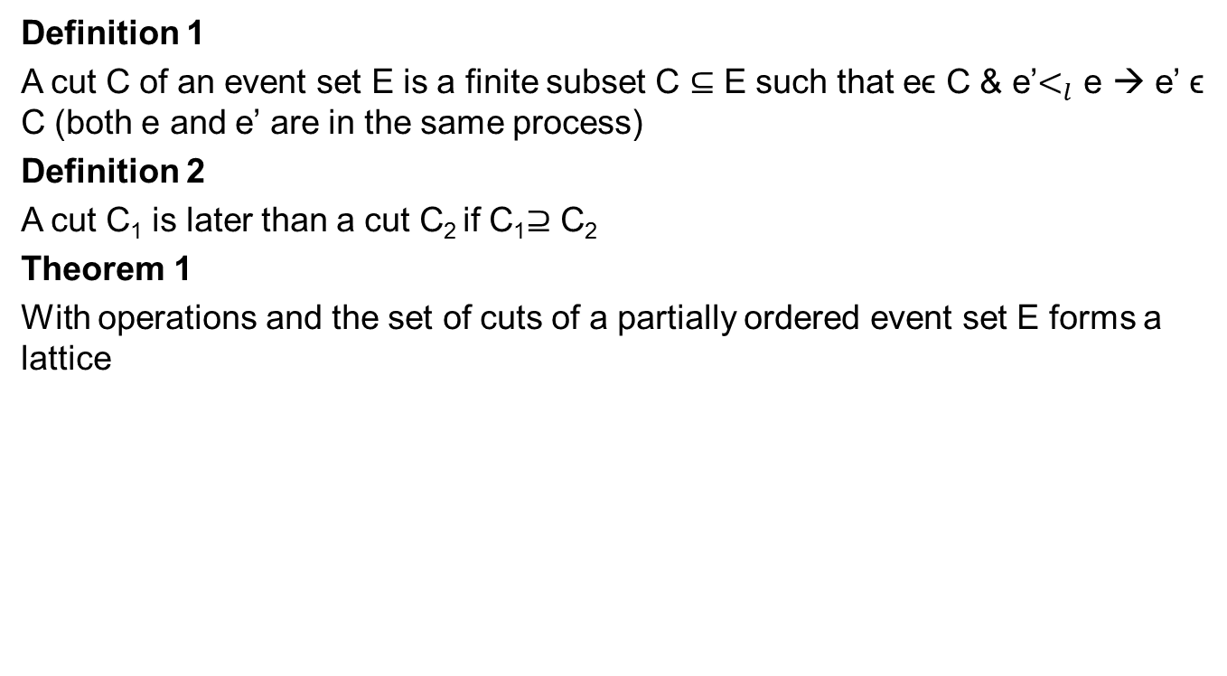
Consistent Cuts
Definition 1
A cut C of an event set E is a finite subset C $⊆$ E such that eϵ C & e’$<_{l}$ e → e’ ϵ C (both e and e’ are in the same process)
Definition 2
A cut C₁ is later than a cut C₂ if C₁$⊇$ C₂
Theorem 1
With operations and the set of cuts of a partially ordered event set E forms a lattice

Slide 9
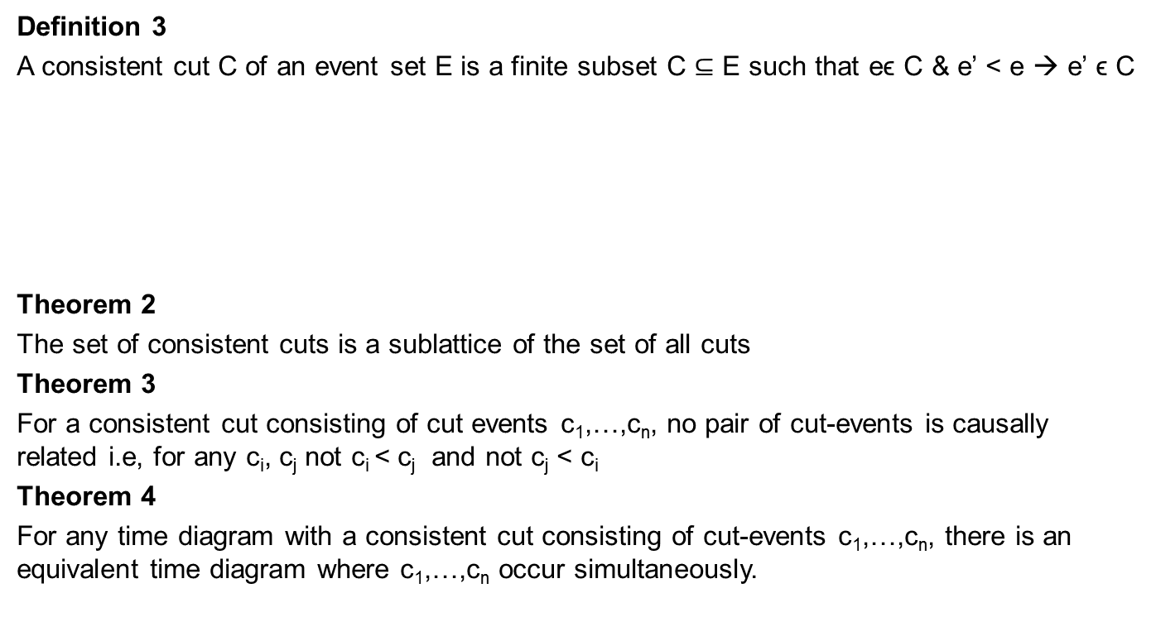
Consistent Cuts
Definition 3
A consistent cut C of an event set E is a finite subset C $⊆$ E such that eϵ C & e’ < e → e’ ϵ C
Theorem 2
The set of consistent cuts is a sublattice of the set of all cuts
Theorem 3
For a consistent cut consisting of cut events c₁,…,c_{n}, no pair of cut-events is causally related i.e, for any c_{i}, c_{j} not c_{i} < c_{j} and not c_{j} < c_{i}
Theorem 4
For any time diagram with a consistent cut consisting of cut-events c₁,…,c_{n}, there is an equivalent time diagram where c₁,…,c_{n} occur simultaneously.

Slide 10
Global State of Consistent Cuts
According to T4 there is a potential execution go the distributed computation in which all cut events are indeed simultaneous in “real time”
The Global State of a consistent cut comprises:
Local state of each process at the time cut event happens
Set of all messages sent but not yet received
e11
c1
e12
P1
c2
e21
e22
P2
c3
e31
P3
P4
e41
e42
c4
Compare

Slide 11
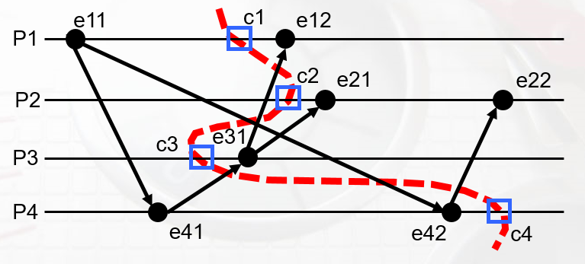
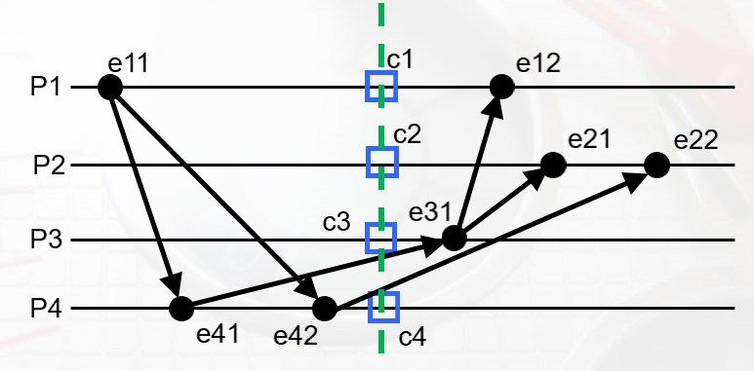
Global State of Consistent Cuts
BEFORE
AFTER
return

Slide 12
Virtual Time
Identifiable only by succession of events (doesn’t flow like real time)
Implemented with counters (Time domain: Natural numbers)
Logical Clock: abstract mechanism where for e ϵ E → C(e) is the timestamp of e
Properties:
if e < e’ then C(e) < C(e’)
Messages context:
C(sent_{Pij}) < C(recieve_{Pji})

Slide 13
Virtual Time
d=1
Tick: C_{i} = C_{i} + d
3
Ci = max(1,2) + d
{msg,ts:2}
Note: C(e) < C(e’) → ¬(‘e<e) BUT (e║e’ OR e < e’ )??

Slide 14
Vector Time
Vector of one Clock for each process
P_{i} has C_{i} as a vector of n processes’ clocks
Tick
C_{i}[i] = C_{i}[i]+1
Updating on receive:
C_{i} = sup(C_{i}, ts)

Slide 15
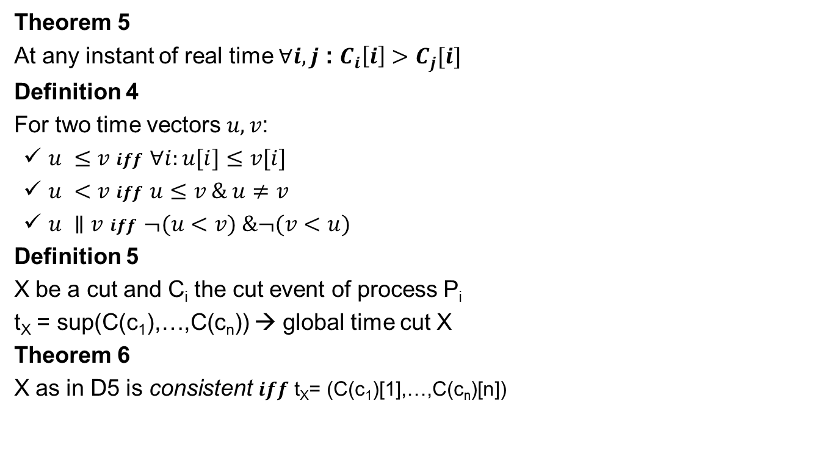
Vector Time
Theorem 5
At any instant of real time $∀i,j$ : $C_{i}\left[i\right]>C_{j}[i]$
Definition 4
For two time vectors $u,v$:
$u ≤v$ 𝒊𝒇𝒇 $∀i:u[i]≤v[i]$
$u <v$ $iff$ $u≤v \& u≠v$
$u ∥v$ $iff$ $¬(u<v) \&¬(v<u)$
Definition 5
X be a cut and C_{i} the cut event of process P_{i}
t_{X} = sup(C(c₁),…,C(c_{n})) → global time cut X
Theorem 6
X as in D5 is consistent $iff$ t_{X}= (C(c₁)[1],…,C(c_{n})[n])

Slide 16
Computing global states on systems without FIFO channels
Create snapshots in Distributed Systems when messages are received in a different order than sent
Theorem: when Ci ticks: ¬Ǝj : C_{i} < C_{j}
First idea:
P_{i} ticks and fix “next” time S as common snapshot time
P_{i} broadcast
P_{i} froze until knows that all other processes know S
P_{i} ticks again and send dummy messages (all processes) ≥ S
Each process takes local snapshot and send it to P_{i} when local clock = S or jump from smaller than S to a value larger than S
Drawback: P_{i} FROZE

Slide 17
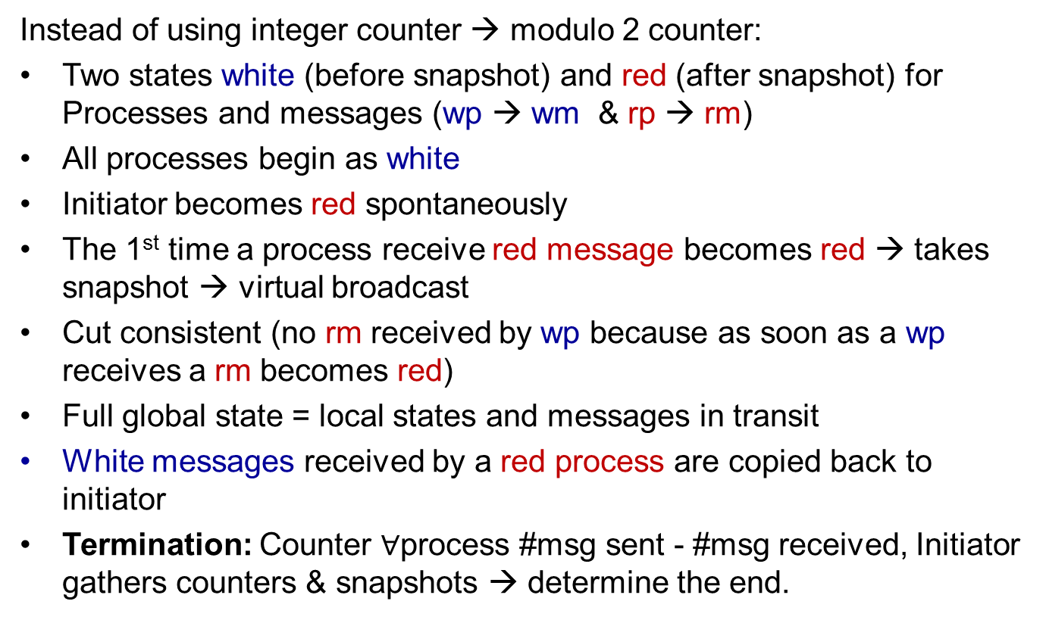
Computing global states on systems without FIFO channels
Instead of using integer counter → modulo 2 counter:
Two states white (before snapshot) and red (after snapshot) for Processes and messages (wp → wm & rp → rm)
All processes begin as white
Initiator becomes red spontaneously
The 1st time a process receive red message becomes red → takes snapshot → virtual broadcast
Cut consistent (no rm received by wp because as soon as a wp receives a rm becomes red)
Full global state = local states and messages in transit
White messages received by a red process are copied back to initiator
Termination: Counter $∀$process #msg sent - #msg received, Initiator gathers counters & snapshots → determine the end.

Slide 18

Computing global states on systems without FIFO channels
P1
P1
P2
P2
P3
P3
P4
P4
Wm transit:
0
2
1

Slide 19
THANKS

